Slide 1


YII 1 for PHP Development
JUNNEL T. TORATE
Software Developer

Slide 2
Objectives
Basic understanding of the structure, concepts, and help to promote rapid application development (RAD), which saves time, helps build more stable applications, and reduces the amount of repetitive coding for developers.
Take away performing tedious coding tasks using pre-built modules and spend time on developing the actual application rather than re-building the foundation.
Awareness of using modern PHP frameworks to improve knowledge and skills to easily adapt other frameworks more flexible.

Slide 3
Course Outline
Introduction to PHP: The PHP Environment, Software and Frameworks
PHP Programming with YII 1
Web UI using Bootstrap
Database Connection
Generating Code with Gii
Git: Clone, Add, Commit and Push
Exercise: Develop Web Application

Slide 4
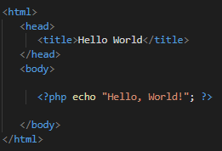
Introduction
PHP (Hypertext Preprocessor)
Server-side scripting language
Used to manage dynamic content, databases, session tracking, even build entire e-commerce sites
Performs system functions like create, open, read and write files
Handle pages to view, add, edit and delete data from the database
Result:

Slide 5
Web Server
The basic objective of the web server is to store, process and deliver web pages to the users.
Intercommunication is done through Hypertext Transfer Protocol (HTTP)

Slide 6
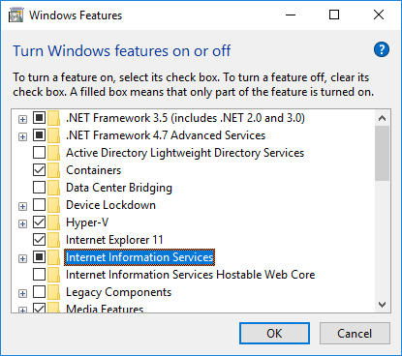
Microsoft IIS
Internet Information Services
IIS is a web server software package designed for Windows.
It is used for hosting websites and other content on the Web.

Slide 7
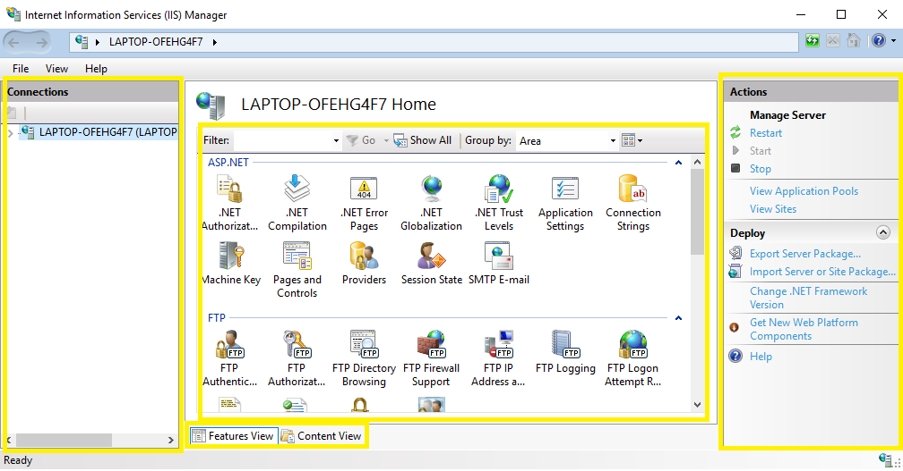
IIS Web Server: Internet Information Services

Slide 8
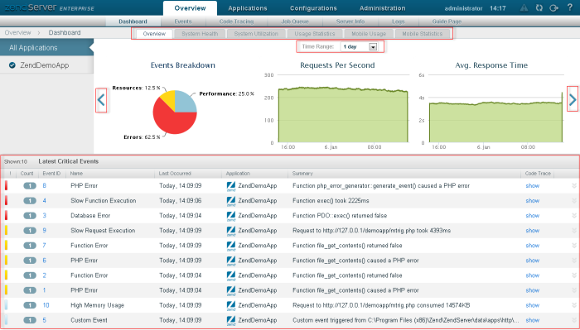
Zend Server
Zend Server is a complete and certified PHP distribution stack fully maintained and supported by Zend Technologies.
It is includes over 80 PHP extensions and supports Apache, NGINX and IIS Web servers.

Slide 9
Code Editors and IDE
Code Editor
Small piece of software like a text editor.
It highlights special keywords, give suggestions, automatic indentation features and other has a integrated terminal.
IDE (Integrated Development Environment)
Has more sophisticated complex functionalities to make the developer life more easy.
It supports debugging, build automation tools, Git plug-ins, code generators, managing project history and etc.

Slide 10
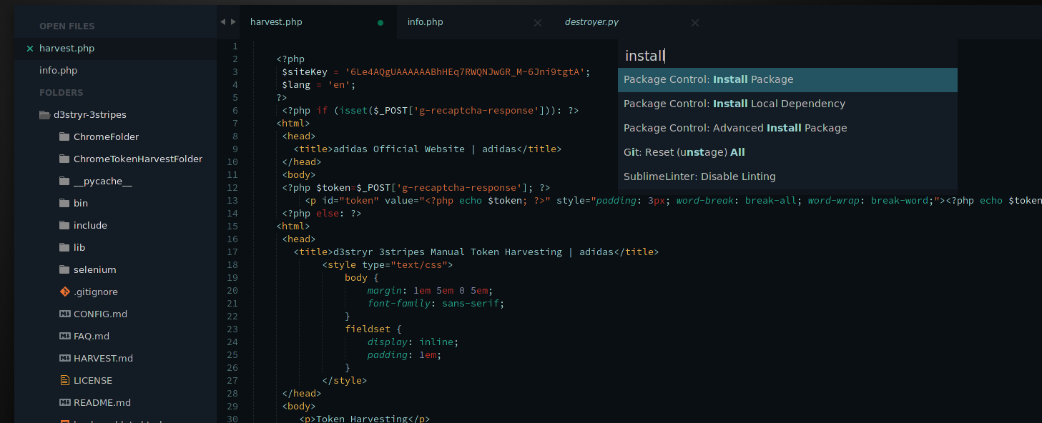
Sublime Text
Sublime Text is a fast and lightweight cross-platform code editor packed with features and plug-ins.
With its “Goto Anything” keyboard shortcut, you can easily jump to any symbol or line of code within your program.

Slide 11
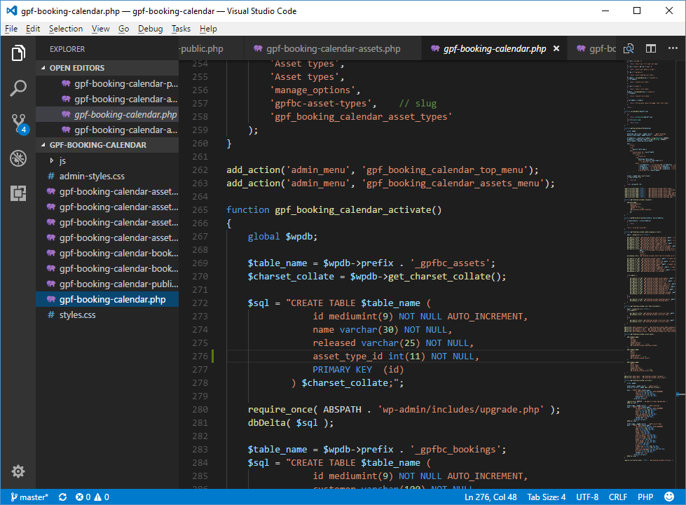
Visual Studio Code
Visual Studio Code is a cross-platform (Linux, Mac OS, Windows) editor that can be extended with plug-ins.
IntelliSense
Debugging
Built-in Git

Slide 12

PHP Frameworks
Advantages
Speed up custom web application development
Simplify web application maintenance
Work with databases more efficiently
Automate common web development tasks
Protect websites from targeted security attacks
Perform unit testing efficiently
No need to increase web development cost

Slide 13
PHP Frameworks
Disadvantages
Programmers need to learn PHP frameworks instead of PHP Basics
Quality of PHP frameworks differs
Lack of option to modify core behavior
Affect speed and performance of websites
13

Slide 14
YII Framework
Yii is an open source, object-oriented, component-based MVC PHP web application framework.
Pronounced as “Yee” and in Chinese it means “simple and evolutionary” and it can be an acronym for “Yes It Is!”.
Light-weight and equipped with caching mechanisms, suited for high-traffic applications, such as portals, forums, content management systems (CMS), e-commerce systems, etc.

Slide 15
Yii 1.1 Installation
Download Yii Framework from this link.
Unpack the Yii release file to a Web-accessible directory.
Requirements:
After installing Yii, to verify that your server satisfies Yii's requirements, you can do so by accessing the requirement checker script via the following URL in a Web browser: http://hostname/path/to/yii/requirements/index.php
e.g. http://localhost/yii-app/yii/requirements/index.php

Slide 16

Creating Your First Yii Application
Using yiic (command line tool) to create a new Yii application
Assume that YiiRoot is the directory where Yii is installed, and WebRoot is the document root of our Web server
Run yiic on the command line as follows:
% YiiRoot/framework/yiic webapp WebRoot/yii-app

Slide 17
Creating Your First Yii Application
This will create a skeleton Yii application under the directory WebRoot/yii-app
By accessing the following URL in a Web browser:
http://localhost/yii-app/index.php
The application has four default pages: the homepage, the about page, the contact page and the login page.
The contact page displays a contact form that users can fill in to submit their inquiries to the webmaster, and the login page allows users to be authenticated before accessing privileged contents.

Slide 18
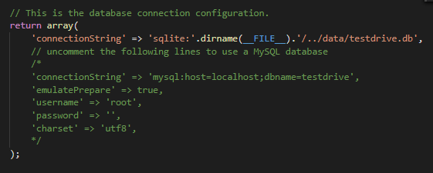
Database Connection
WebRoot/yii-app/protected/config/database.php
The above code is the default database connection
Instructs Yii that the application should connect to the SQLite database:
WebRoot/yii-app/protected/data/testdrive.db

Slide 19
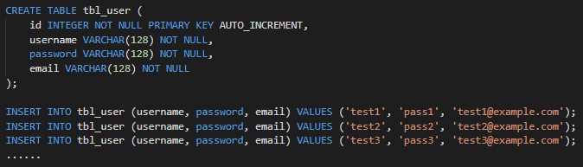
Connecting to MySQL Database
In MySQL GUI, create a database named: testdrive
Select that database and execute the SQL file found in this directory:
WebRoot/yii-app/protected/data/schema.mysql.sql
The SQL schema contains only a single table named tbl_user with the initial data to be inserted.

Slide 20

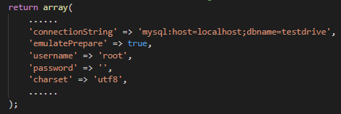
Connecting to MySQL Database
Edit the file: WebRoot/yii-app/protected/config/database.php
In editor, comment the following line of code:
Uncomment the following lines of code to connect in MySQL Database:

Slide 21
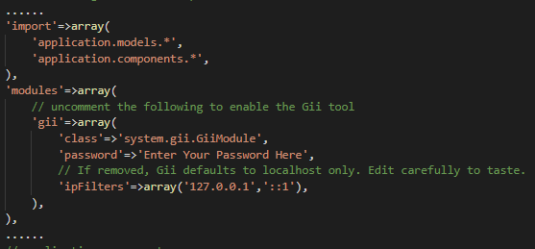
Gii
A powerful Web-based code generator
Configuring Gii:
Edit the file: WebRoot/yii-app/protected/config/main.php
Uncomment the Gii module and update the password

Slide 22
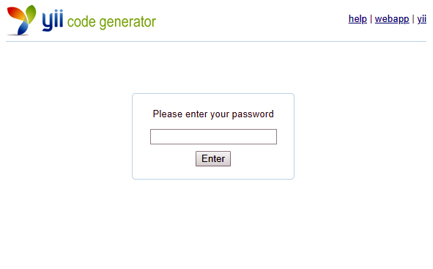
Gii Page
Visit the URL http://localhost/yii-app/index.php?r=gii
Login page will be prompted for a password

Slide 23
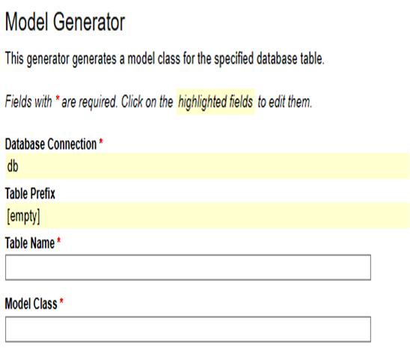
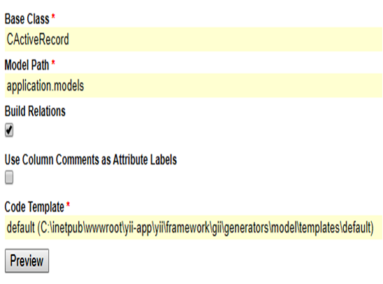
Generating the User Model
After login, click on the link Model Generator.
This will bring us to the following model generation page.

Slide 24
Generating the User Model
Enter the following values to generate model file:
Table Name: tbl_user
Model Class: User
Press the Preview button
This will show us the new code file to be generated
Press the Generate button
A new file named User.php will be generated under protected/models
This User model class allows us to talk to the underlying database tbl_user table in an object-oriented fashion.

Slide 25
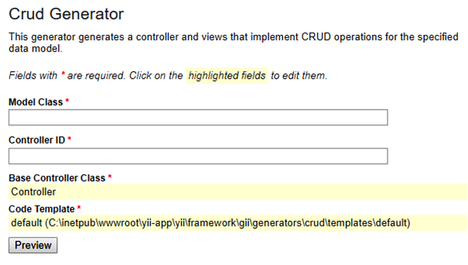
Generating User CRUD Code
In Gii page, click on the link Crud Generator.
Generate the code that implements the CRUD operations

Slide 26
Generating User CRUD Code
Enter the following values to generate CRUD files:
Model Class: User
Controller ID: user (in lower case)
Press the Preview button
This will show us the new code files to be generated
Press the Generate button
A new file named UserController.php will be generated under protected/controllers
And, view files under protected/views/user used for the front-end

Slide 27
Accessing User CRUD Pages
Visit the URL http://localhost/yii-app/index.php?r=user
This will display a list of user entries in the tbl_user table.
Pages Access Rules
Allow all users (*) - List User, View User
Allow authenticated user (@) - Create User, Update User
Allow admin user (admin) - Manage User, Delete User

Slide 28
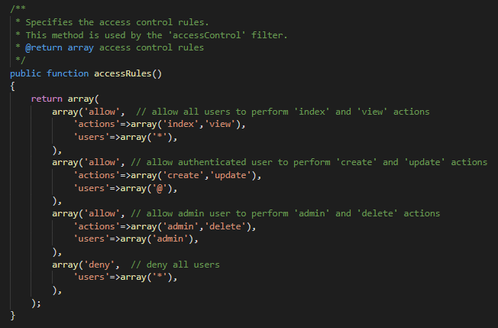
Controller Access Control Rules
WebRoot/yii-app/protected/controllers/UserController.php

Slide 29
Bootstrap
Bootstrap is the most popular CSS Framework for developing responsive and mobile-first websites.
Advantages
Ensure cross-browser compatibility
Allow website to adapt in various screen sizes – mobile and desktop
Add consistency to design and code between projects and between developers
Disadvantage
Lot of requirements to style overrides or rewriting the files tends for customization of design used in Bootstrap.

Slide 30

Install Bootstrap Extension in YII
Download bootstrap extension from this link.
Unpack the file archive to WebRoot/yii-app/protected/extensions.
Configuring Extension:
Edit the file: WebRoot/yii-app/protected/config/main.php
In editor, add the following line of code before starting of array:
Yii::setPathOfAlias('bootstrap', dirname(__FILE__).'/../extensions/bootstrap');

Slide 31
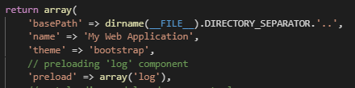
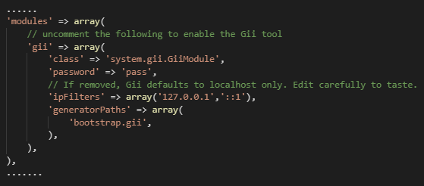
Install Bootstrap Extension in YII
Edit the file: WebRoot/yii-app/protected/config/main.php
In editor, add the following line of code:
In editor, add the following line of codes inside Gii module:

Slide 32
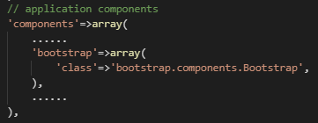
Install Bootstrap Extension in YII
Edit the file: WebRoot/yii-app/protected/config/main.php
In editor, add the following line of codes inside the components:

Slide 33
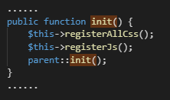
Install Bootstrap Extension in YII
Edit the file: WebRoot/yii-app/protected/extensions/ boostrap/components/Bootstrap.php
In editor, add the following line of codes inside the class:

Slide 34
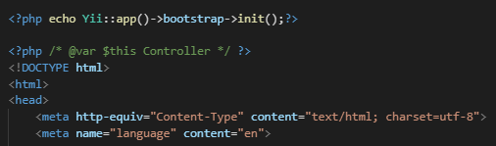
Install Bootstrap Extension in YII
Edit the file: WebRoot/yii-app/protected/views/layout/main.php
In editor, add the following line of code before the <html> tag:

Slide 35
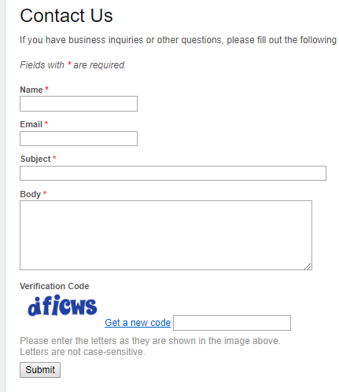
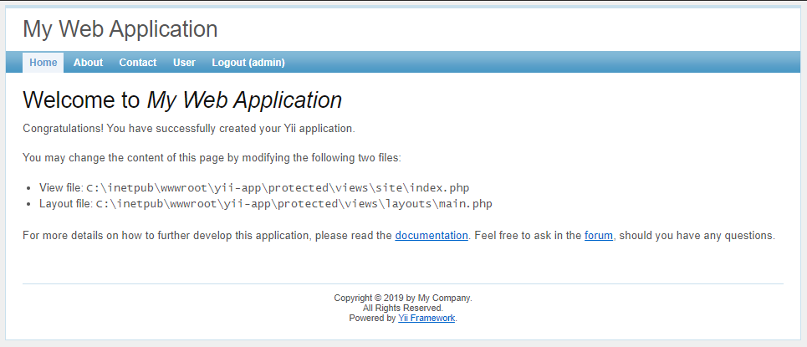
Install Bootstrap Extension in YII
Default classic template:

Slide 36
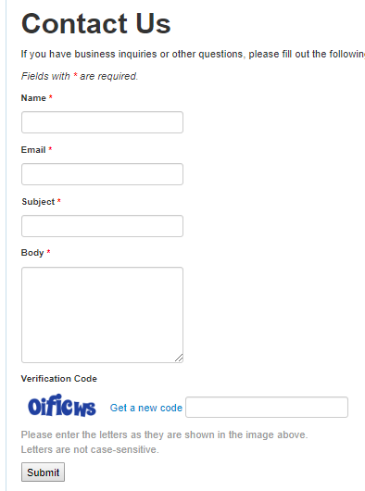
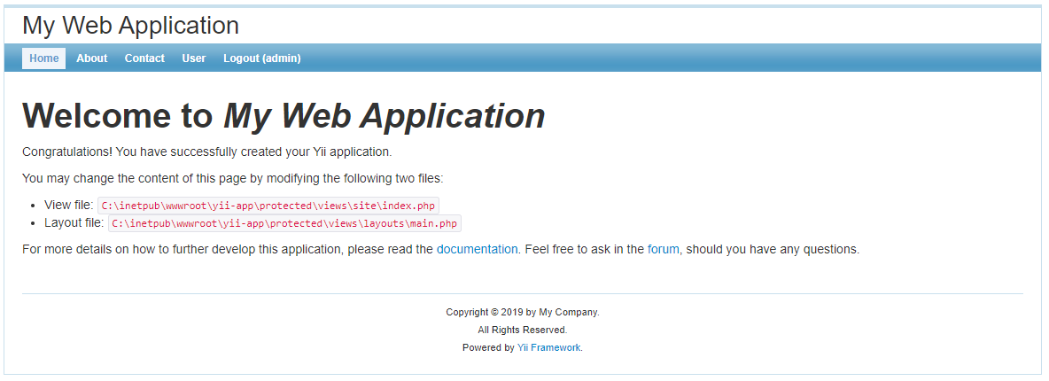
Install Bootstrap Extension in YII
Bootstrap template:

Slide 37
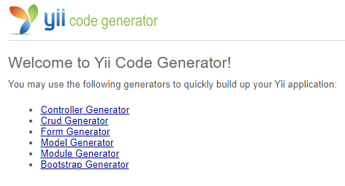
Bootstrap Generator
Bootstrap Generator creates CRUD using bootstrap widgets

Slide 38
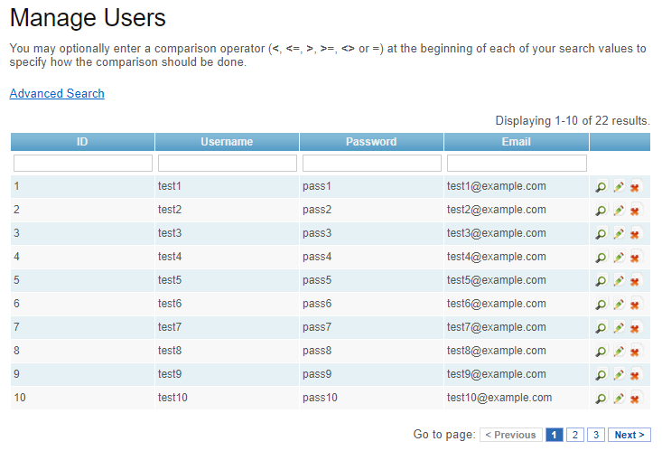
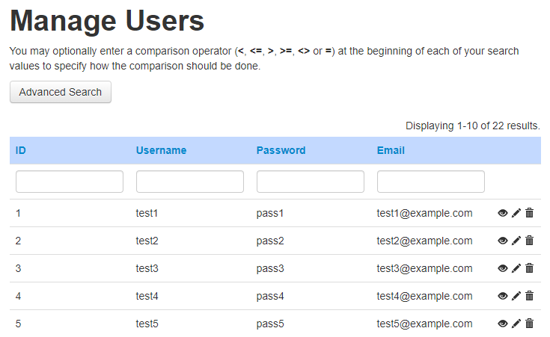
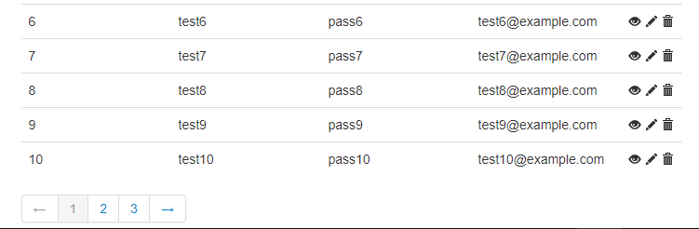
GridView Widget
Default
Bootstrap

Slide 39
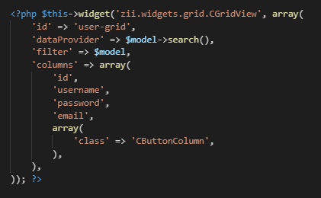
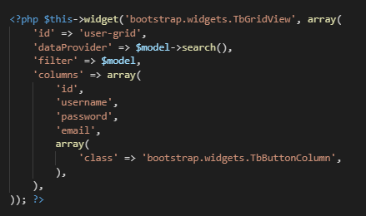
Widget
Difference between default widget and bootstrap widget
Default Widget
Bootstrap Widget

Slide 40
Connect it to GitHub
GitHub is a Git repository hosting service.
Git is a command line tool while GitHub provides a Web-based graphical interface.
Start a new git repository:
Go to github.com.
Log in to your account.
Click the new repository button in the top-right. You’ll have an option there to initialize the repository with a README file.
Click the “Create repository” button.

Slide 41
Git Push
Open a Git Bash or a Command-Line in this directory WebRoot/yii-app
Follow this set of instructions to “Push an existing repository” to GitHub
Visit the URL https://github.com/<username>/yii-app to view the code repository
git init
git remote add origin https://github.com/<username>/yii-app.git
git add .
git commit -m "first commit"
git push -u origin master

Slide 42

Exercise
Create “Message” System
Create Message
List Message
Guest
(unauthenticated user)
Administrator
(admin user)
Manage Message
Delete Message
View Message
Update Message

Slide 43
Exercise
Guest
Can create a message
Can view list of message
Administrator
Can create a message
Can view list of message
Can manage list of message
Can update message
Can delete message

Slide 44








Slide 45
References
https://www.tutorialspoint.com/php/php_introduction.htm
https://economictimes.indiatimes.com/definition/web-server
https://dzone.com/articles/the-5-most-popular-code-editors-for-2018
https://stackoverflow.com/questions/30527522/what-are-the-differences-between-visual-studio-code-and-visual-studio
https://code.visualstudio.com/
https://medium.com/@mindfiresolutions.usa/advantages-and-disadvantages-of-php-frameworks-c046d50754e5
https://en.wikipedia.org/wiki/Yii
https://www.yiiframework.com/doc/guide/1.1/en/quickstart.what-is-yii
https://github.com/yiisoft/yii/releases/download/1.1.21/yii-1.1.21.733ac5.tar.gz
https://gunnarpeipman.com/vs-code-php-development/
https://techterms.com/definition/iis
https://en.wikipedia.org/wiki/Zend_Server
https://raygun.com/blog/top-php-frameworks/
https://www.quora.com/What-is-the-use-of-code-editor
https://www.w3schools.com/whatis/whatis_bootstrap.asp
https://webbymonks.com/blog/what-are-the-pros-cons-of-foundation-and-bootstrap/

Slide 46
References
https://www.taniarascia.com/what-is-bootstrap-and-how-do-i-use-it/
https://techcrunch.com/2012/07/14/what-exactly-is-github-anyway/
https://kbroman.org/github_tutorial/pages/init.html

